Slide 1
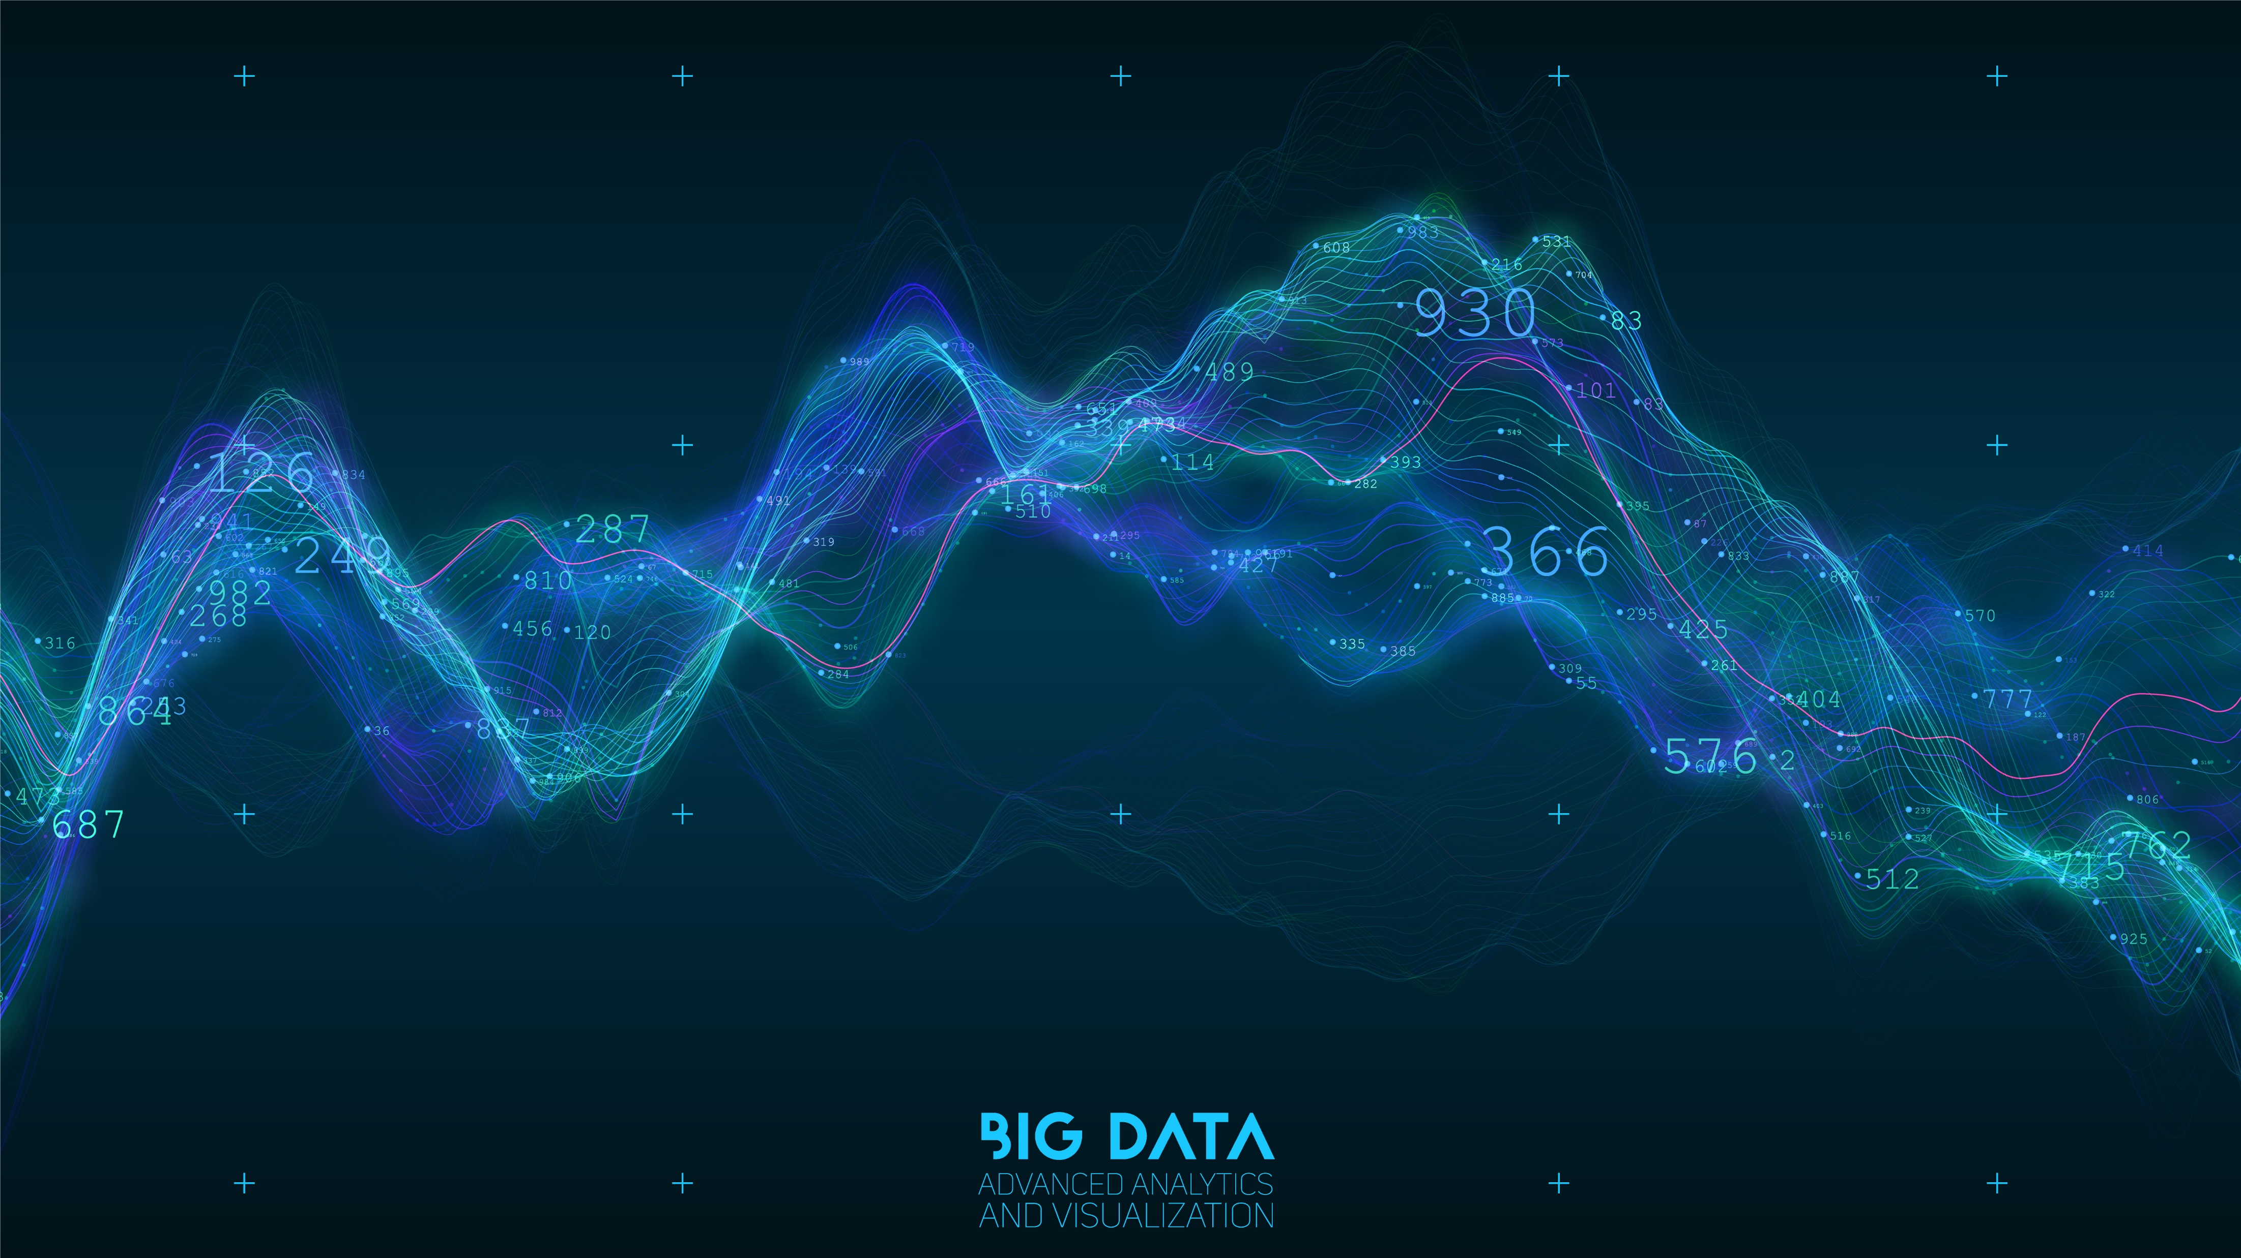

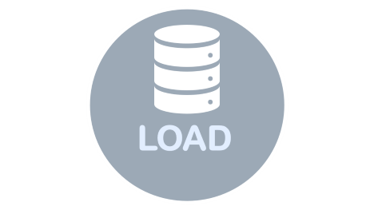

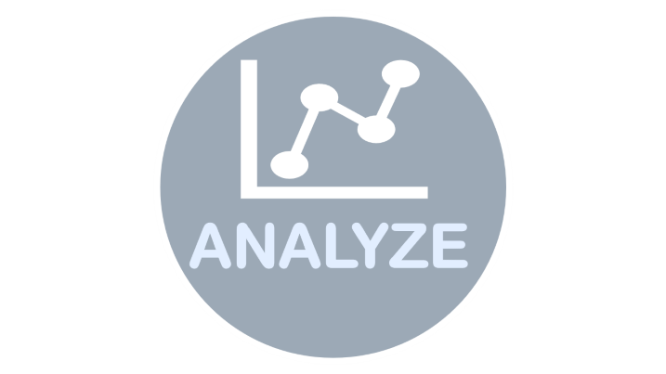
ETL PROCESS

Slide 2

EXTRACT

Slide 3


EXTRACT
During the extract phase of ETL, someone in the organization identifies the desired data sources and the rows, columns, and fields to be extracted from those sources. These sources likely include:
Transactional databases hosted on-site or in the cloud
Hosted business applications

Slide 4

TRANSFORM

Slide 5


TRANSFORM
Transformation refers to the cleansing and aggregation that may need to happen to data to prepare it for analysis. Architecturally speaking, there are two ways to approach ETL transformation:
Multistage data transformation
In-warehouse data transformation

Slide 6

LOAD

Slide 7


LOAD
The load stage of the ETL process depends largely on what you intend to do with the data once it’s loaded into the data warehouse.

Slide 8

ANALYZE

Slide 9


ANALYZE
Big data analysis is processed within the warehouse, enabling the business to gain insight from the correctly configured data.

